Slide 1
Syntax Directed Translation
Course Code: CSC3220
Course Title: Compiler Design
Dept. of Computer Science
Faculty of Science and Technology
Lecturer No: | 5 | Week No: | 5 | Semester: | Summer 20_21
Lecturer: | Nazia Hossain; nazia@aiub.edu

Slide 2
Lecture Outline
Syntax Directed Translation
Syntax Directed Definition
Synthesized Attribute
Inherited Attribute
Syntax Directed Translation Scheme
Class Exercises

Slide 3
Objectives and Outcomes
Objectives:
Understand the Semantics of the language.
Understand the evaluation process of input by the compiler.
Outcomes:
Students should be able to understand the annotated parse tree.
Students will analyze how to construct the input from infix to postfix by the compiler.

Slide 4
Syntax Directed Translation
Syntax-directed translation is done by attaching rules or program fragments to
productions in a grammar. For example, consider an expression expr generated
by the production
expr -» expr + term
Here, expr is the sum of the two subexpressions expr and term. (The subscript
in expr is used only to distinguish the instance of expr in the production body
from the head of the production). We can translate expr by exploiting its
structure, as in the following pseudo-code:
translate expr;
translate term;
handle +;

Slide 5
Syntax Directed Translation
There are two notations for attaching semantic rules:
Syntax Directed Definitions
Syntax Directed Translation Schemes

Slide 6
Syntax Directed Definitions
Syntax Directed Definitions are a generalization of context-free grammars in which:
Grammar symbols have an associated set of Attributes;
Productions are associated with Semantic Rules for computing the
values of attributes.
Important Note: Such formalism generates Annotated Parse Tree where each node of the tree is a record with a field for each attribute( e.g expr.t indicates the attribute t of the grammar symbol expr)

Slide 7
Syntax Directed Definitions
Here Semantic Rule is applied for one production of a context free grammar.
This production derives an expression containing a plus operator. The left operand of the plus operator is given by expr and the right operand by term. The semantic rule associated with this production constructs the value of attribute expr.t by concatenating the postfix forms expr.t and term.t of the left and right operands, respectively, and then appending the plus sign. This rule is a formalization of the definition of "postfix expression“. The symbol || in the semantic rule is the operator for string concatenation.
Production Semantic Rule
expr → expr + term expr.t := expr.t || term.t || ‘+’
9+5
95+

Slide 8
Syntax Directed Definitions
Production Semantic Rule
expr → expr + term expr.t := expr.t || term.t || ‘+’
expr → expr – term expr.t := expr.t || term.t || ’-’
expr → term expr.t := term.t
term → 0 term.t := ‘0’
term → 1 term.t := ‘1’
…. ….
term → 9 term.t := ‘9’

Slide 9
Syntax Directed Definitions
We applied semantic rules for each production of a context-free grammar. Now we will see how semantic rules are embedded in parse tree.
Fig: Annotated Parse Tree
expr.t =95-2+
expr.t =95-
term.t =2
expr.t =9
term.t =5
term.t =9
9
-
5
+
2

Slide 10
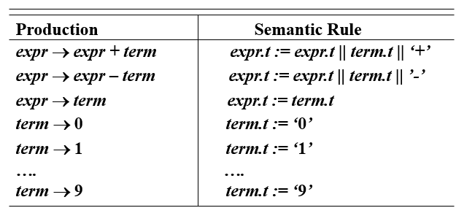
Input: 9-5+2
expr.t = 95-2+
expr
expr.t= 95-
term.t=2
expr
term
+
expr.t = 9
expr
-
term
2
Term.t=5
term.t=9
term
5
9

Slide 11
Input string: 9-5+2
expr.t=95-2+
expr
Bottom to top
Left to right
expr.t=95-
expr
term
term.t=2
+
Now we are going to convert
The infix notation (input) into
Postfix notation (according to
The semantic rule)
expr
expt.t = 9
term
2
-
term.t=5
term
term.t = 9
5
9

Slide 12
Syntax Directed Definitions
It starts at the root and recursively visits the children of each node in left-to-right order.
The semantic rules at a given node are evaluated once all descendants of that node have been visited.
A parse tree showing all the attribute values at each node is called annotated parse tree.

Slide 13
Syntax Directed Definitions
Attribute Grammars: Each grammar symbol has an associated set of attributes. An attribute can represent anything we choose:
The value of an expression when literal constants are used
The data type of a constant, variable, or expression
The location (or offset) of a variable in memory
The translated code of an expression, statement, or function
We distinguish between two kinds of attributes:
Synthesized Attributes.
Inherited Attributes.

Slide 14
Syntax Directed Definitions
Synthesized Attributes: An attribute is synthesized if the attribute value of parent is determined from attribute values of children in the parse tree.
Example:
Production Semantic Rule
expr → expr + term expr.t := expr.t || term.t || ‘+’
expr → expr – term expr.t := expr.t || term.t || ’-’
expr → term expr.t := term.t
term → 0 term.t := ‘0’
term → 1 term.t := ‘1’
…. ….
term → 9 term.t := ‘9’

Slide 15
Syntax Directed Definitions
expr.t =95-2+
expr.t =95-
term.t =2
expr.t =9
term.t =5
term.t =9
9
-
5
+
2
Fig: Annotated Parse Tree

Slide 16
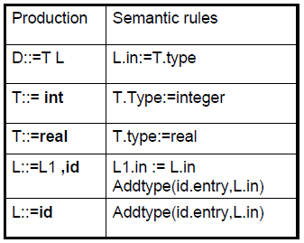
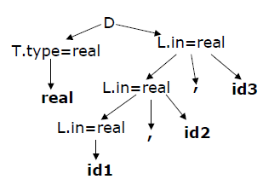
Syntax Directed Definitions
Inherited Attributes: An attribute is inherited if the attribute value of a parse-tree node is determined from attribute values of its parent and siblings.
Example:

Slide 17
Syntax Directed Translation Schemes
Syntax Directed Translation Schemes: A translation scheme is a context free grammar in which
Attributes are associated with grammar symbols
Semantic actions are enclosed between braces {} and are inserted within the right-hand side of productions.
Production Semantic Action
expr → expr + term {print(‘+’)}
expr → expr – term {print(‘ - ’)}
expr → term {print( )}
term → 0 {print(‘0’)}
term → 1 {print(‘1’)}
…. ….
term → 9 {print(‘9’)}

Slide 18
Production Semantic Action
expr → expr + term {print(‘+’)}
expr → expr – term {print(‘ - ’)}
expr → term {print( )}
term → 0 {print(‘0’)}
term → 1 {print(‘1’)}
…. ….
term → 9 {print(‘9’)}
A translation scheme is like a syntax-directed definition except the order of evaluation of the semantic rules is explicitly shown.
expr
{print(‘+’)}
Input: 9-5+2
+
expr
term
-
{print(‘-’)}
2
{print(‘2’)}
expr
term
5
{print(‘5’)}
Output: 95-2+
term
9
{print(‘9’)}

Slide 19
Class Exercises
Show the annotated parse tree for the following expressions.
2*3+4
2+3-4/5

Slide 20
Lecture References
A. Aho, R. Sethi and J. Ullman, Compilers: Principles, Techniques and Tools
(The Dragon Book), [ Second Edition]

Slide 21
References
A. Aho, R. Sethi and J. Ullman, Compilers: Principles, Techniques and Tools(The Dragon Book), [ Second Edition]
Principles of Compiler Design (2nd Revised Edition 2009) A. A. Puntambekar
Basics of Compiler Design Torben Mogensen

